Slide 1
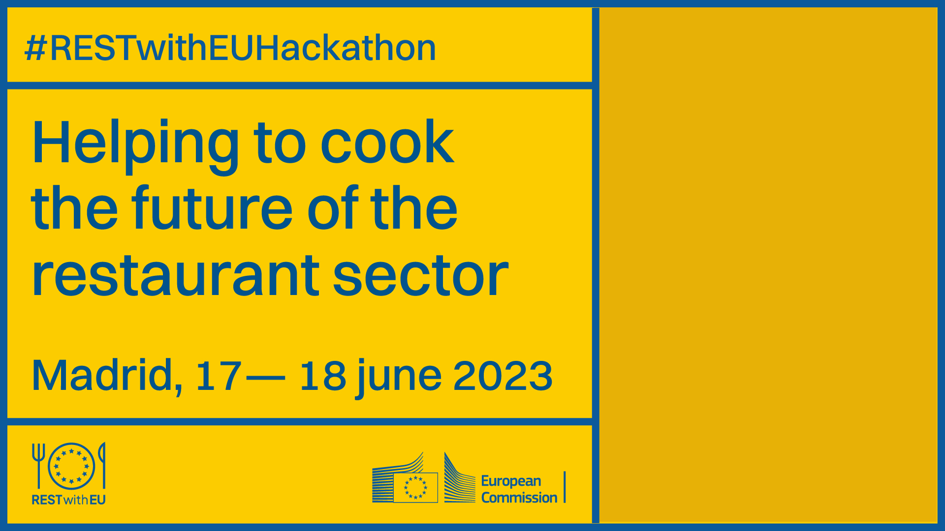


Slide 2
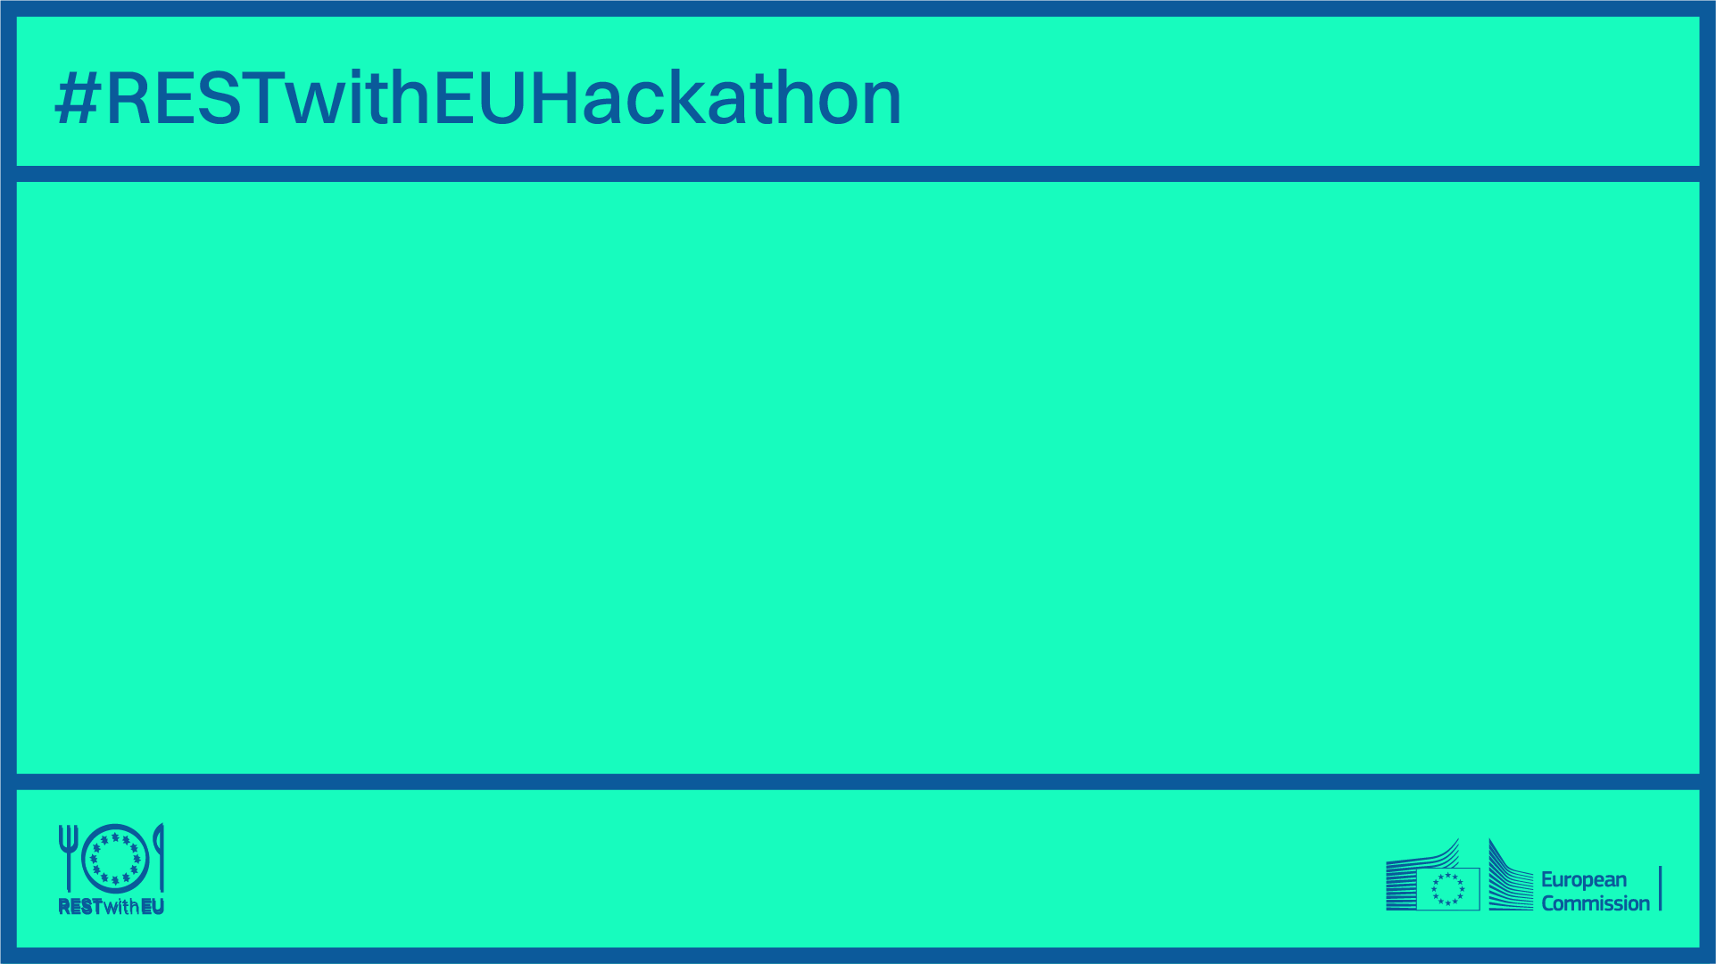
During this hackathon, the main challenges of the restaurant field will be issued through innovative solutions and a unique prototype created in two days.

Slide 3

CHALLENGE 1 – STREAMLINING OPERATIONS
Business intelligence and data analytics solutions that can help restaurant SMEs optimize their processes by providing real-time data on inventory levels, customer demand and staff availability.

Slide 4

CHALLENGE 2 - ENHANCING THE CUSTOMER EXPERIENCE
Attract and retain customers, improving customer experience in a highly competitive market. Restaurants need solutions in processes such as ordering, personalized customer recommendations or loyalty programs to increase revenue and gain a competitive advantage.

Slide 5

CHALLENGE 3 - MANAGING ONLINE PRESENCE AND REPUTATION
Online presence and reputation are important for restaurant SMEs due to online reviews and social media. Solutions to manage reputation, track feedback, and engagement with customers online can help build a base of loyal customers and gain a competitive advantage in the market.

Slide 6

CHALLENGE 4 – MITIGATING FOOD WASTE IN THE RESTAURANT INDUSTRY
A new digital solution approach to sustainability and cost savings. It is estimated that the average restaurant generates thousands of pounds of food waste each year, resulting in significant costs and inefficiencies. Stock monitoring and optimization, partnering with food banks or startups, or better demand foresight can give restaurants more efficiency.

Slide 7
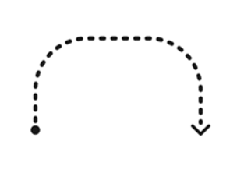





Hackathon process
In the mark of our creative and design process we will focus on 5 stages in which we will creatively solve the proposed challenge, always focusing on the final user or group.
To do so, we will start collecting as much information as we have about the challenge, and then gradually define a solution, person, and prototype.
DESIGN THINKING
LEAN STARTUP
Ideation / Brainstorming: how can we solve this issue?
Prototype: how is perceived our idea?
How do we create it?
Definition of the challenge: which kind of issue we will face?
Definition of the idea: what is our idea?
Presentation of the idea: how will we present our solution?

Slide 8
YOUR TEAM
Icebreaker question: “What has been your best restaurant experience so far?"
Who is your dream team composed by?
Hot pot
Spice up your customer experience
Name and role
Name and role
Name and role
Name and role
Name and role

Slide 9
Challenge conceptualization workshop
30'

Slide 10
Challenge definition – Empathise with the different issues
Individual reflection and response will be set out, sharing and bearing into mind the point of view and personal experience of each team participant. A dialogue will be generated on the basis and origin of the challenge that has been posed in order to reach a greater concreteness of the problem. The objective is to choose among all team members one of the problems by voting based on the criteria detailed in the next slide.
PLAYER 1
What does this challenge mean for you?
Which issue do you identify it with?
PLAYER 2
What does this challenge mean for you?
Which issue do you identify it with?
PLAYER 3
What does this challenge mean for you?
Which issue do you identify it with?
PLAYER 4
What does this challenge mean for you?
Which issue do you identify it with?
PLAYER 5
What does this challenge mean for you?
Which issue do you identify it with?
PLAYER 6
What does this challenge mean for you?
Which issue do you identify it with?

Slide 11
Challenge definition – Empathise with the restaurants SME
ASSESSMENT CRITERIA
SCALE AND SCOPE OF THE PROBLEM
POTENTIAL IMPACT
SIMPLICITY AND AGILITY TO SOLVE
RESTAURANT SME FOCUS
ATTRACTIVE CONTENT TO DEVELOP
AFFINITY WITH THE CHALLENGE
SELECTED CRITERIA
( )

Slide 12
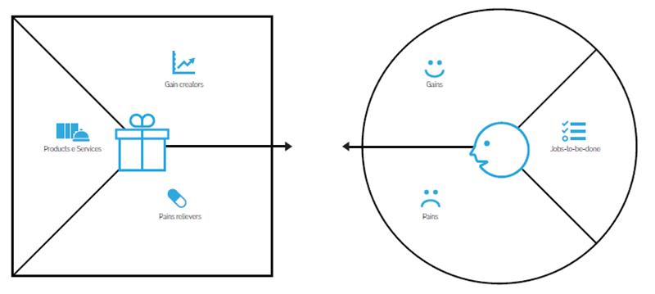


Challenge definition – Empathise with the restaurants SME Who is concerned by the issue? In which ways?
What is the differentiating factor of this solution from others?
How would the client like to feel once the solution has been implemented?
How does the client feel about the issue?
How this solution will improve the current situation?
What sort of circumstances must exist for us to achieve our desired outcomes?
Which benefits would this solution offer to the client?

Slide 13
Challenge definition – What issue will we solve?
Title – Write down the issue you will solve here
Key challenge to solve Describe clearly the challenge. What is the challenge? Why is this challenge real? Why is it so important to solve? What key issue have we identified? What needs, concerns, and complaints do the restaurants SME have? | Benefits What would be the major benefits in case of solving the problem? In which ways would it affect the restaurants SME?

Slide 14
Challenge definition – Summary Design Scope
____________[restaurants SME] need ____________[need of the restaurants SME] because ____________[insight].

Slide 15
Let’s work in teams!
BRAINSTORMING

Slide 16
Challenge definition – Summary Design Scope
How might we solve... the challenge

Slide 17



Ideation – Ice Breaker
How would this personality solve the challenge?

Slide 18
Ideation – Brainstorming
What challenge is going to be solved?
Individual brainstorming and presentation of the ideas to the team
1
Individual ideas
Classify and sort ideas by similarity and affinity of concept and development
2
Group of related ideas
Decision of final idea to be developed and prototyped
Final idea
3

Slide 19
Let's group the ideas by theme
Don't be afraid of crazy ideas! The more the better!
We prioritize
Selected idea

Slide 20
Product Design Workshop
30'

Slide 21
Challenge definition – Empathise with the restaurants SME Who is concerned by the issue? In which ways?
What is the differentiating factor of this solution from others?
How would the client like to feel once the solution has been implemented?
How does the client feel about the issue?
How this solution will improve the current situation?
What sort of circumstances must exist for us to achieve our desired outcomes?
Which benefits would this solution offer to the client?

Slide 22
Idea definition
What is our idea? Solution sheet
HOT POT 🌶️ – The rising issue of food intolerances, tastes diets and allergies. Cost saving .Waiter , kitchen. Possible upselling
Describe our idea Idea: Digital tool to make on demand meal modification easier and efficient for SMEs restaurants. Cost and time saving. Increase income. Value proposition: Customization API powered by AI to bring personalizes meals into the restaurants. Restaurants SME and key-actors | Challenge resolution Attract and retain customers, improving customer experience in a highly competitive market
Waiter, Chef, Owner, (Provider), Client To provide and adaptable solution that can fit in their existing solutions without need of any development | Benefits Save time, money, happy clients, improve customer loyalty trought attention. Alternatives for minor groups. Menu design and creation without need a high-profile chef. Reduce food waste. Digital transformation adaptation,
Technology /methodology POS, Analytics, AI, real time adjustments based on product availability. Suggest new menus based on analytics from previous orders and current ingredients in the kitchen | Objectives Increase customer satisfaction Constant process digitalization Increase the SMEs digitalization

Slide 23

First day done!

Slide 24
Prototype

Slide 25
Prototype Workshop
60'

Slide 26

Prototype
Wireframes – What is it and how will be used?
Wireframes are visual structures that represent digital solution skeleton that represent our solution.
What is the process to carry out our wireframes?
How do we imagine it? First rough exercise, name the first functions, first picture of the key elements and factors of our solution.
Flowchart of our digital solution: tidying up exercise representing actions, features, connections, and relationships.
3. First screens of the digital solution.
Wireframes

Slide 27
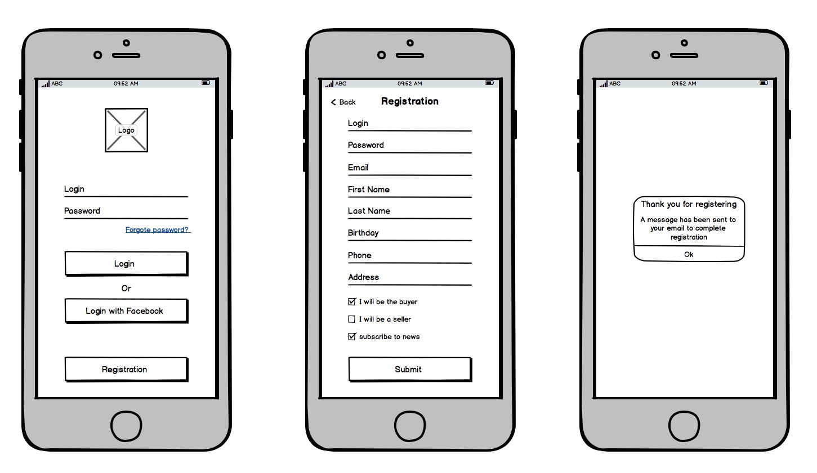
Wireframes
Which factors can we imagine for our solution?
First rough exercise: first picture of the key elements and factors of our idea.
Example of how to make a first rough by pencil.

Slide 28
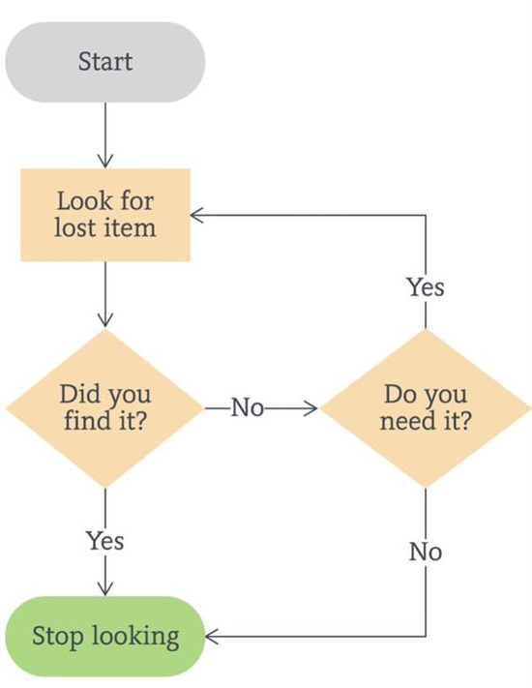
Wireframes
2. Flowchart of our digital solution
Tiding exercise to put into order the structure by representing characteristics, connexions and relations.
Example of how to make a first flowchart of the digital solution to know what order the restaurants SME is going to take at beginning.

Slide 29
1
2
3
4
5
6
7
Step 1
Step 2
Step 3
Step 4
Step 5
Step 6
Step 7
Decision 1
Decision 2

Slide 30
Prototype Wireframes A

Slide 31

Prototype Wireframes B

Slide 32
Prototype
Storyboard
What is the process of our restaurants SME using the digital solution? The storyboard allow us to explain the process of our digital solution trough draws which will serve as guide to understand the sense of the issue.
Which problem the restaurants SME are confronted to?
How do he currently solve it?
Our solution
How does he use our solution?
How does he use our solution?
How does he use our solution?
How do we solve his issue?
What are the benefits for the restaurants SME?

Slide 33

Prototype
Your turn

Slide 34
Idea presentation
pitch

Slide 35
Elevator Pitch Workshop
30'

